Slide 1
http://www.vidyanidhi.com/
ketkiacharya.net@gmail.com
Ketki Acharya
From: SM VITA ATC of CDAC
9769201036
ketkiacharya.net@gmail.com

Slide 2
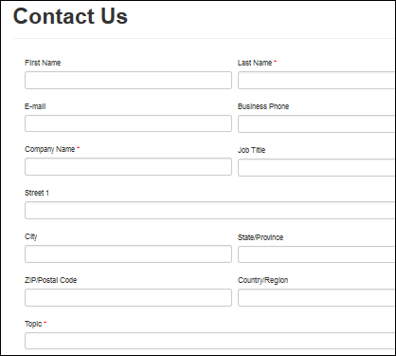
What is data Base?
A database is a collection of data that is organized, which is also called structured data. It can be accessed or stored in a computer system [Permanent storage]. It can be managed through a Database Management System (DBMS).
You get data as one record eg. Employee name , address, Salary, Department etc
The file system is basically a way of arranging the files in a storage medium like a hard disk [Permanent storage].
You get data as string type and it is not structured data.
http://www.Microsoft.com
Server With
ASP/JSP/PHP/Dijango engine
Server capture read this data
and map with table column
Class Employee{
String Firstname;
String Lastname;
String Email;
}
You fill up form and submit to server
{Firstname: “Vidya”,
Lastname:”Nidhi”
Email:”training.vita@gmail.com”
……
}
MySql RDBMS
Firstname | Lastname | Email
Vidya | Nidhi | training….
Submit

Slide 3
What is Database
Database Management System
Database management system is a software which is used to manage the database. For example: MySQL, Oracle, etc are a very popular commercial database which is used in different applications.
DBMS provides an interface to perform various operations like database creation, storing data in it, updating data, creating a table in the database and a lot more.
It provides protection and security to the database. In the case of multiple users, it also maintains data consistency.
The database is a collection of inter-related data which is used to retrieve, insert and delete the data efficiently. It is also used to organize the data in the form of a table, schema, views, and reports, etc.
For example: The college Database organizes the data about the admin, staff, students and faculty etc.
Using the database, you can easily retrieve, insert, and delete the information.
What is Data?
Data is a collection of a distinct small unit of information. It can be used in a variety of forms like text, numbers, media, bytes, etc. it can be stored in pieces of paper or electronic memory, etc.
Word 'Data' is originated from the word 'datum' that means 'single piece of information.' It is plural of the word datum.
In computing, Data is information that can be translated into a form for efficient movement and processing. Data is interchangeable.

Slide 4
Advantages of DBMS
Controls database redundancy: It can control data redundancy because it stores all the data in one single database file and that recorded data is placed in the database.
Data sharing: In DBMS, the authorized users of an organization can share the data among multiple users.
Easily Maintenance: It can be easily maintainable due to the centralized nature of the database system.
Reduce time: It reduces development time and maintenance need.
Backup: It provides backup and recovery subsystems which create automatic backup of data from hardware and software failures and restores the data if required.
multiple user interface: It provides different types of user interfaces like graphical user interfaces, application program interfaces
Characteristics of DBMS
It uses a digital repository established on a server to store and manage the information.
It can provide a clear and logical view of the process that manipulates data.
DBMS contains automatic backup and recovery procedures.
It contains ACID properties which maintain data in a healthy state in case of failure.
It can reduce the complex relationship between data.
It is used to support manipulation and processing of data.
It is used to provide security of data.
It can view the database from different viewpoints according to the requirements of the user.
Disadvantages of DBMS
Cost of Hardware and Software: It requires a high speed of data processor and large memory size to run DBMS software.
Size: It occupies a large space of disks and large memory to run them efficiently.
Complexity: Database system creates additional complexity and requirements.
Higher impact of failure: Failure is highly impacted the database because in most of the organization, all the data stored in a single database and if the database is damaged due to electric failure or database corruption then the data may be lost forever.

Slide 5
What Is ACID
Atomicity
Atomicity ensures that a transaction is treated as a single, indivisible unit. Either all operations within the transaction are completed successfully, or none are applied. If any part of the transaction fails, the entire transaction is rolled back, leaving the database unchanged. For example, in a bank transfer, if money is deducted from one account but fails to be credited to another, atomicity ensures the deduction is reversed.
Consistency
Consistency ensures that a database remains in a valid state before and after a transaction. Transactions must adhere to all defined rules, constraints, and relationships within the database. For instance, in a banking system, the total balance across all accounts should remain constant before and after a transfer, ensuring no data corruption occurs.
Isolation
Isolation ensures that concurrent transactions do not interfere with each other. Each transaction operates as if it is the only one being executed, preventing issues like dirty reads, non-repeatable reads, or phantom reads. For example, if two users are updating the same record simultaneously, isolation ensures that one transaction's changes are not visible to the other until committed.
Durability
Durability guarantees that once a transaction is committed, its changes are permanent, even in the event of a system crash. This is achieved by writing the changes to non-volatile storage. For example, after a successful bank transfer, the updated balances are saved to disk, ensuring they persist even if the system fails immediately afterward.

Slide 6
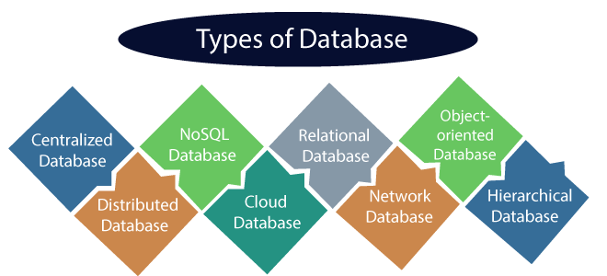
Types of Databases
Relational Database
This database is based on the relational data model, which stores data in the form of rows(tuple) and columns(attributes), and together forms a table(relation). A relational database uses SQL for storing, manipulating, as well as maintaining the data. Mr. E.F. Codd invented the database in 1970. Each table in the database carries a key that makes the data unique from others. Examples of Relational databases are MySQL, Microsoft SQL Server, Oracle, etc.
Properties of Relational Database
There are following four commonly known properties of a relational model known as ACID properties, where:
A means Atomicity: This ensures the data operation will complete either with success or with failure. It follows the 'all or nothing' strategy. For example, a transaction will either be committed or will abort.
C means Consistency: If we perform any operation over the data, its value before and after the operation should be preserved. For example, the account balance before and after the transaction should be correct, i.e., it should remain conserved.
I means Isolation: There can be concurrent users for accessing data at the same time from the database. Thus, isolation between the data should remain isolated. For example, when multiple transactions occur at the same time, one transaction effects should not be visible to the other transactions in the database.
D means Durability: It ensures that once it completes the operation and commits the data, data changes should remain permanent.

Slide 7
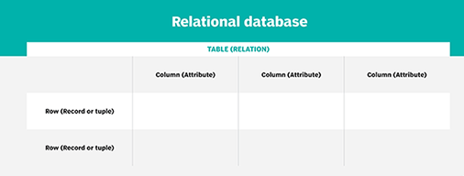
What is the structure of a relational database model?
Mr. E. F. Codd, then a programmer at IBM, invented the relational database in 1970. In his paper "A Relational Model of Data for Large Shared Data Banks,"
Codd proposed shifting from storing data in hierarchical or navigational structures to organizing data in a tabular structure of tables containing rows and columns.
Each table, sometimes called a relation, in a relational database contains one or more data categories in columns, or attributes. Each row, also called a record or tuple, contains a unique instance of data, or key, for the categories defined by the columns. Each table has a unique primary key that identifies the information in a table. The relationship between tables can be set via the use of foreign keys -- a field in a table that links to the primary key of another table.
A relational database includes tables containing rows and columns.
For example, a typical business order entry database would include a table that describes a customer with columns for name, address, phone number and so forth. Another table would describe an order, including information like the product, customer, date and sales price.
A user can get a database report showing the data they need. For example, a branch office manager might want a report on all customers who bought products after a certain date. A financial services manager in the same company could, from the same tables, obtain a report on accounts that need to be paid.

Slide 8

Two constraints relate to data integrity and the primary and foreign keys:
Entity integrity ensures that the primary key in a table is unique and the value is not set to null.
Referential integrity requires that every value in a foreign key column will be found in the primary key of the table from which it originated.
ID | EmpName | DeptId
1 | Reena | 102
2 | Rohan | 101
3 | Kavita | 102
DeptID | DeptName
101 | HR
102 | MKT
DeptId is foreign key in emp table

Slide 9
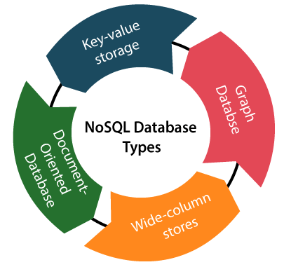
NoSQL Database
Non-SQL/Not Only SQL is a type of database that is used for storing a wide range of data sets. It is not a relational database as it stores data not only in tabular form but in several different ways. It came into existence when the demand for building modern applications increased. Thus, NoSQL presented a wide variety of database technologies in response to the demands. We can further divide a NoSQL database into the following four types:
Key-value storage: It is the simplest type of database storage where it stores every single item as a key (or attribute name) holding its value, together.
Document-oriented Database: A type of database used to store data as JSON-like document. It helps developers in storing data by using the same document-model format as used in the application code.
Graph Databases: It is used for storing vast amounts of data in a graph-like structure. Most commonly, social networking websites use the graph database.
Wide-column stores: It is similar to the data represented in relational databases. Here, data is stored in large columns together, instead of storing in rows.
Advantages of NoSQL Database
It enables good productivity in the application development as it is not required to store data in a structured format.
It is a better option for managing and handling large data sets.
It provides high scalability.
Users can quickly access data from the database through key-value.

Slide 10
Cloud Database
A type of database where data is stored in a virtual environment and executes over the cloud computing platform. It provides users with various cloud computing services (SaaS, PaaS, IaaS, etc.) for accessing the database. There are numerous cloud platforms, but the best options are:
Amazon Web Services(AWS)
Microsoft Azure
Kamatera
PhonixNAP
ScienceSoft
Google Cloud SQL, etc.

Slide 11
What is table
The RDBMS database uses tables to store data. A table is a collection of related data entries and contains rows and columns to store data.
A table is the simplest example of data storage in RDBMS.
Let's see the example of student table.
Data Integrity
There are the following categories of data integrity exist with each RDBMS:
Entity integrity: It specifies that there should be no duplicate rows in a table.
Domain integrity: It enforces valid entries for a given column by restricting the type, the format, or the range of values.
Referential integrity: It specifies that rows cannot be deleted, which are used by other records. Eg. You can not delete department when there are employee to whom Department is allocated.
User-defined integrity: It enforces some specific business rules that are defined by users. These rules are different from entity, domain or referential integrity.
ID | Name | AGE | COURSE
1 | Ajeet | 24 | B.Tech
2 | aryan | 20 | C.A
3 | Mahesh | 21 | BCA
4 | Ratan | 22 | MCA
5 | Vimal | 26 | BSC
NULL Values
The NULL value of the table specifies that the field has been left blank during record creation. It is totally different from the value filled with zero or a field that contains space.

Slide 12
What is field
Field is a smaller entity of the table which contains specific information about every record in the table. In the above example, the field in the student table consist of id, name, age, course.
ID | Name | AGE | COURSE
What is row or record
A row of a table is also called record. It contains the specific information of each individual entry in the table. It is a horizontal entity in the table. For example: The above table contains 5 records.
Let's see one record/row in the table.
1 | Ajeet | 24 | B.Tech
ID
1
2
3
4
5
Name
Ajeet
aryan
Mahesh
Ratan
Vimal
What is column
A column is a vertical entity in the table which contains all information associated with a specific field in a table. For example: "name" is a column in the above table which contains all information about student's name.

Slide 13
Data model Schema and Instance
The data which is stored in the database at a particular moment of time is called an instance of the database.
The overall design of a database is called schema.
A database schema is the skeleton structure of the database. It represents the logical view of the entire database.
A schema contains schema objects like table, foreign key, primary key, views, columns, data types, stored procedure, etc.
A database schema can be represented by using the visual diagram. That diagram shows the database objects and relationship with each other.
A database schema is designed by the database designers to help programmers whose software will interact with the database. The process of database creation is called data modeling.
A schema diagram can display only some aspects of a schema like the name of record type, data type, and constraints.

Slide 14
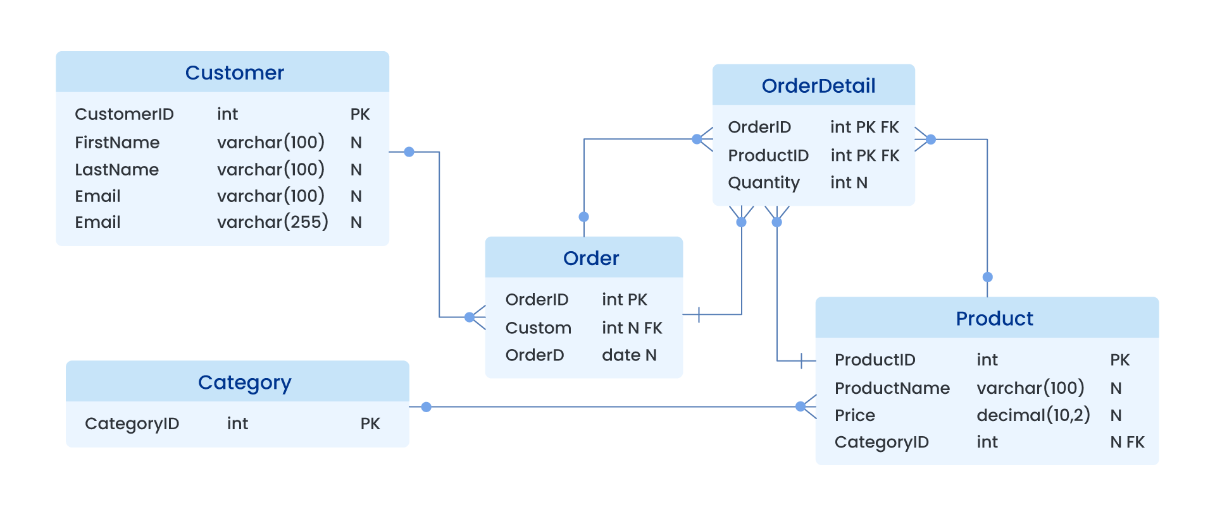
Here are some schema diagram examples that visually represent key aspects like:
Record types (e.g., tables or entities)
Data types (e.g., integer, varchar, date)
Constraints (e.g., primary keys, foreign keys, not null)
These diagrams help illustrate how a database schema is structured, even if they don’t show every detail like triggers or stored procedures.

Slide 15
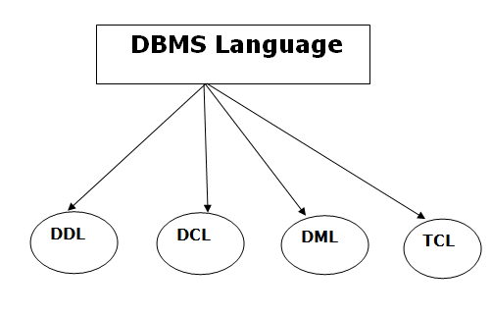
Database Language
Data Definition Language
DDL stands for Data Definition Language. It is used to define database structure or pattern.
It is used to create schema, tables, indexes, constraints, etc. in the database.
Using the DDL statements, you can create the skeleton of the database.
Data definition language is used to store the information of metadata like the number of tables and schemas, their names, indexes, columns in each table, constraints, etc.
Here are some tasks that come under DDL:
Create: It is used to create objects in the database.
Alter: It is used to alter the structure of the database.
Drop: It is used to delete objects from the database.
Truncate: It is used to remove all records from a table.
Rename: It is used to rename an object.
Comment: It is used to comment on the data dictionary.
These commands are used to update the database schema that's why they come under Data definition language.
A DBMS has appropriate languages and interfaces to express database queries and updates.
Database languages can be used to read, store and update the data in the database.
Types of Database Language

Slide 16
Data Manipulation Language
DML stands for Data Manipulation Language. It is used for accessing and manipulating data in a database. It handles user requests.
Data Control Language
DCL stands for Data Control Language. It is used to retrieve the stored or saved data.
The DCL execution is transactional. It also has rollback parameters.
(But in Oracle database, the execution of data control language does not have the feature of rolling back.)
Here are some tasks that come under DCL:
Grant: It is used to give user access privileges to a database.
Revoke: It is used to take back permissions from the user.
Here are some tasks that come under DML:
Select: It is used to retrieve data from a database.
Insert: It is used to insert data into a table.
Update: It is used to update existing data within a table.
Delete: It is used to delete all records from a table.
Merge: It performs UPSERT operation, i.e., insert or update operations.
Call: It is used to call a structured query language or a Java subprogram.
Explain Plan: It has the parameter of explaining data.
Lock Table: It controls concurrency.
Transaction Control Language
TCL is used to run the changes made by the DML statement. TCL can be grouped into a logical transaction.
Here are some tasks that come under TCL:
Commit: It is used to save the transaction on the database.
Rollback: It is used to restore the database to original since the last Commit.

Slide 17
Create: Alter: Drop: Truncate: Rename: Comment:
Commit:
Rollback
Grant,Revoke
Select
Insert
Update
Delete
Merge

